Slide 1
Digital Control System Analysis and Design
Chap. 1 Introduction
Chap. 2 Discrete Time Systems and the z-Transform
Chap. 3 Sampling and Reconstruction
Chap. 4 Open-Loop Discrete-Time Systems
Chap. 5 Closed-Loop Systems
Chap. 6 System Time-Response Characteristics
Chap. 7 Stability Analysis Techniques
Chap. 8 Digital Controller Design

Slide 2
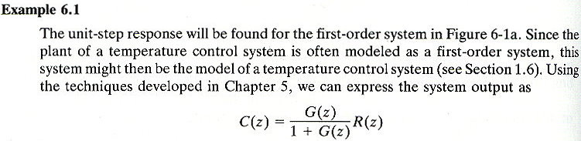
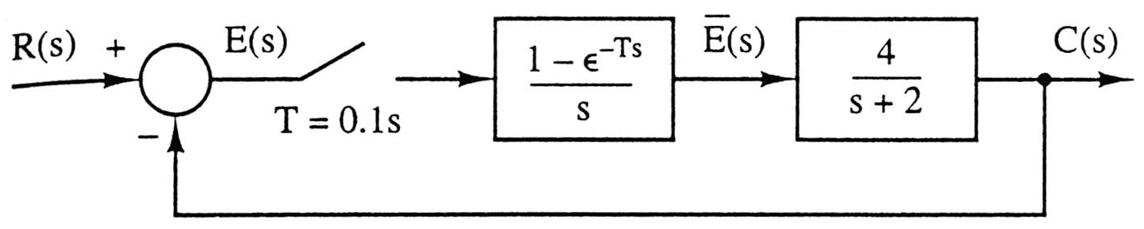
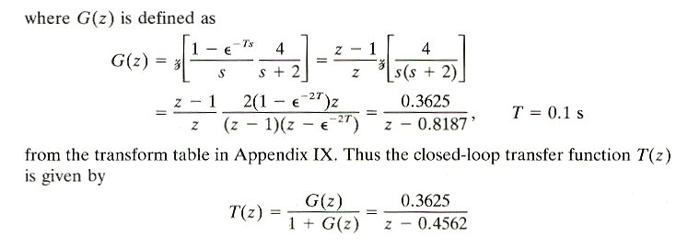
6.2 System Time Response
DT viewpoint
Fig. 6-1 (a)
Appendix VIII

Slide 3
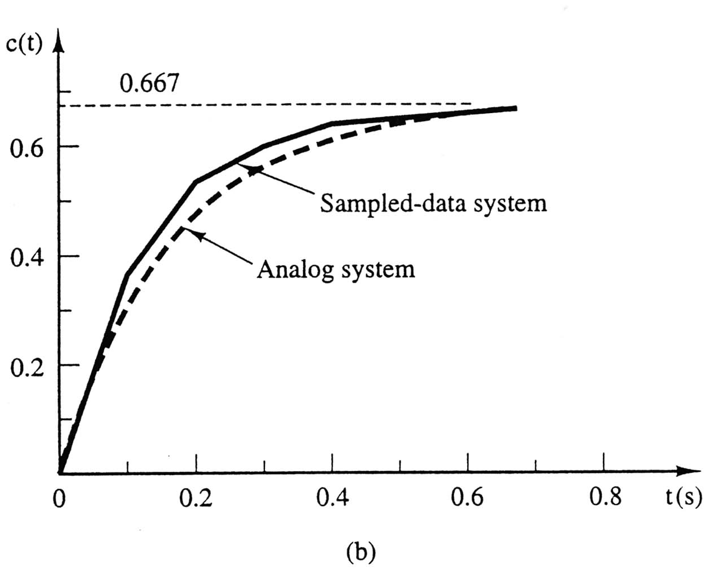
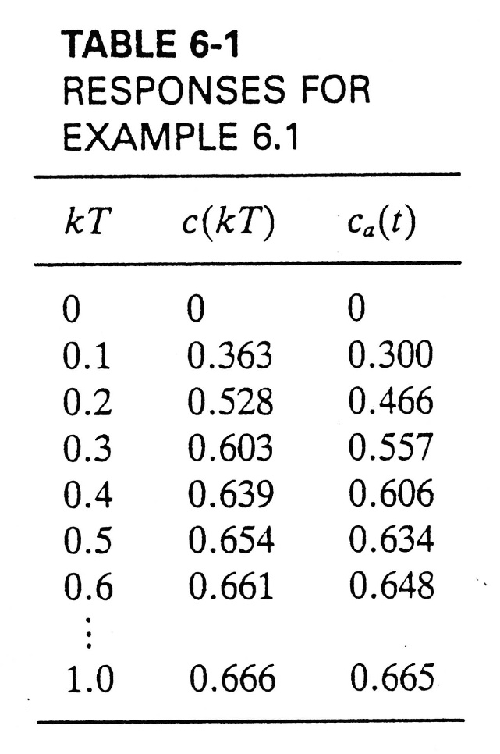
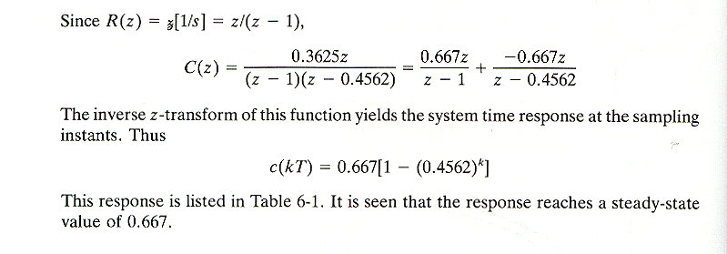
Final value
0.42
Fig. 6-1 (b)
τ=0.167

Slide 4
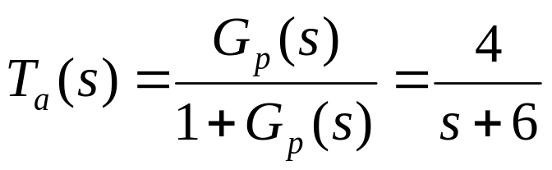
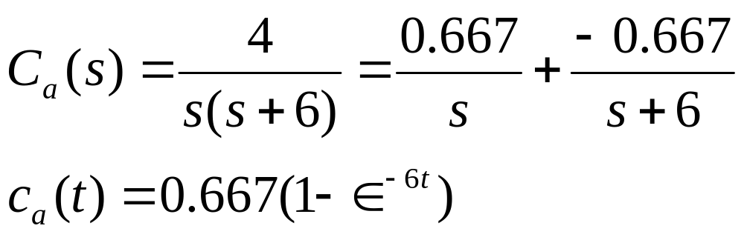
Example 6.2: Analog System
CT viewpoint
To show the effect of sampling.
G_{p}(s)
Fig. 6-1 (a)
Natural/
Transient resp.
Forced/
Steady-state resp.

Slide 5
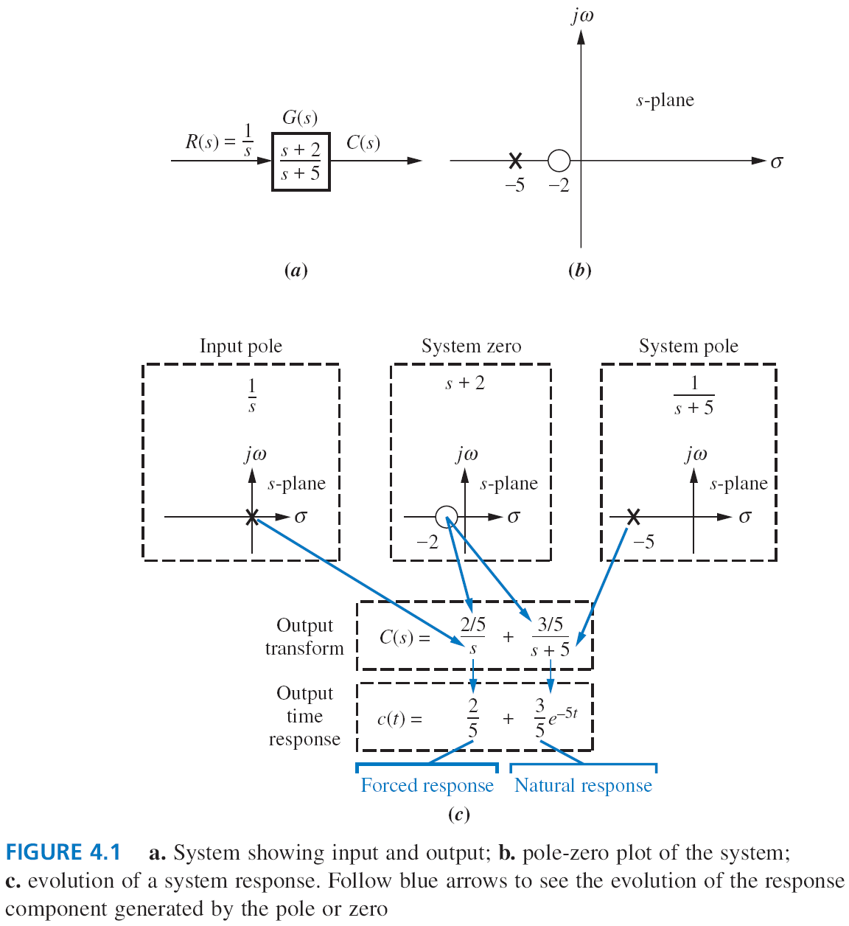
Supplementary Materials
Open-Loop System
Force Resp. (Ch-7)
steady-state resp.
particular sol.
Input
Nat. Resp. (Ch-4)
transient resp.
homogenous sol.
System

Slide 6
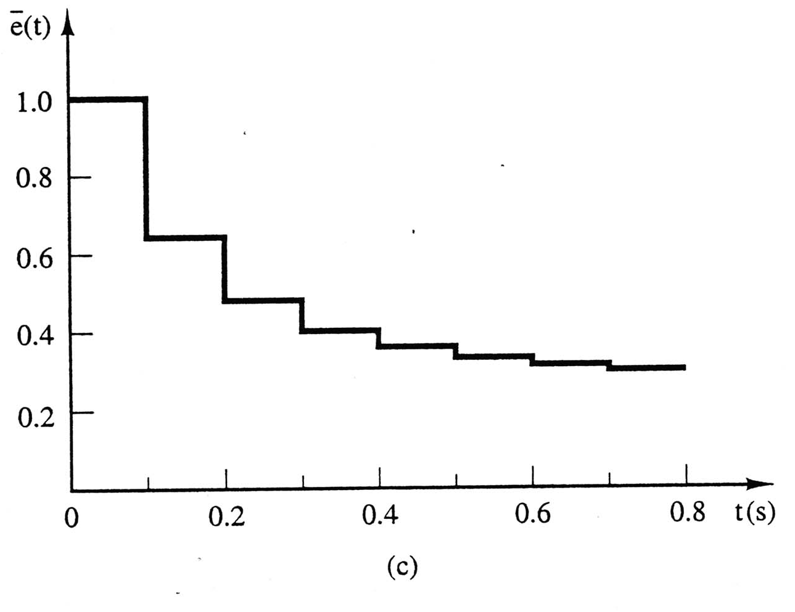
Example 6.2
Final value
Fig. 6-1 (c)
Fig. 6-1 (b)

Slide 7
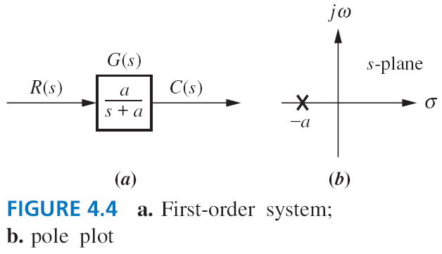
4.3 FIRST-ORDER SYSTEMS
Supplementary Materials
system parameter

Slide 8
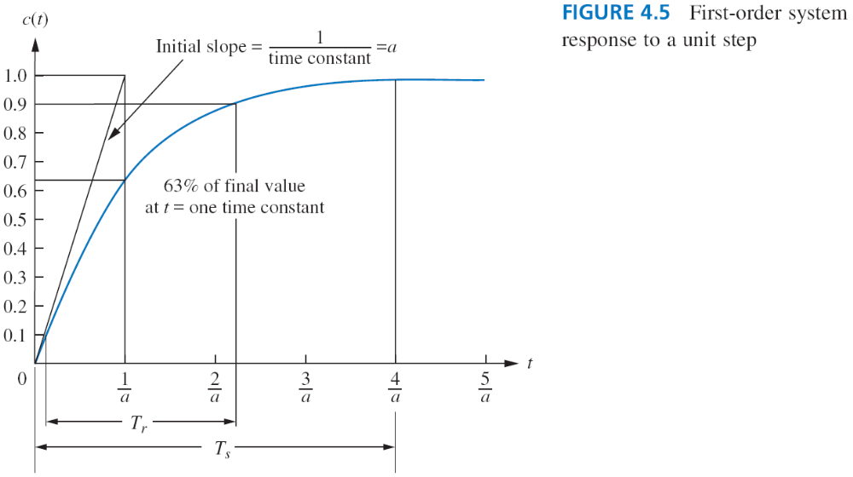
Supplementary Materials
When t = 1/a

Slide 9
Supplementary Materials
TIME CONSTANT, T_{c} = 1/a
描述一階LTI系統中，對隨時間變化的輸入信號的響應能力的參數。
值愈小，其響應變化就愈快。
RISE TIME, T_{r}
SETTLING TIME, T_{s}

Slide 10
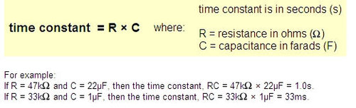
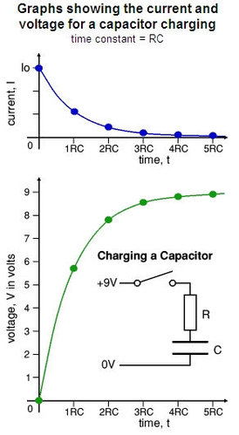
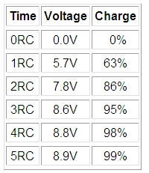
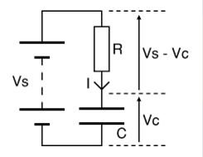
電容器充電 Charging a capacitor
T_{c}
T_{s}
= 4T_{c}
時間常數大，表示電容器充電慢。注意，時間常數是含有電容電阻之電路的特性，它不是電容器本身的特性。
Source: Link

Slide 11
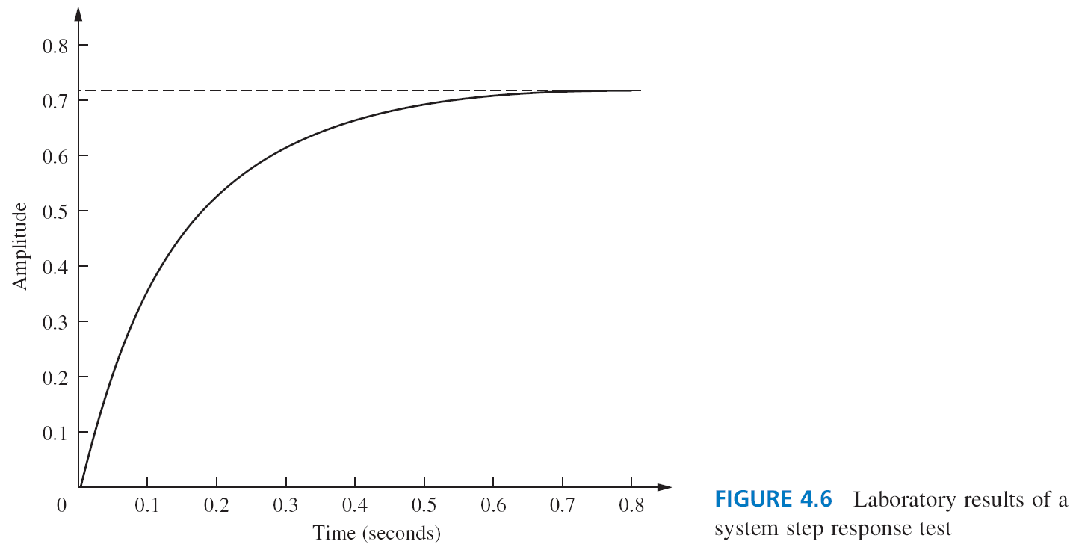
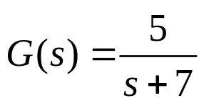
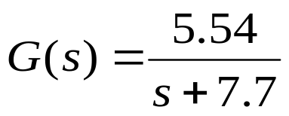
FIRST-ORDER TRANSFER FUNCTION VIA TESTING
Supplementary Materials
System parameters: a and K
Modeling
By step input
c_{ss}=0.72= K/a
63% * 0.72 =0.45
→ T_{c}=0.13
Model (TF)
Real:
T_{c}=0.13

Slide 12
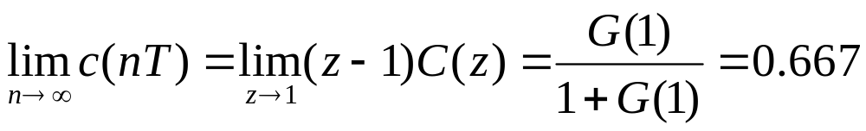
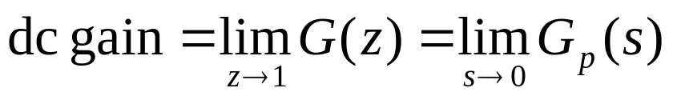
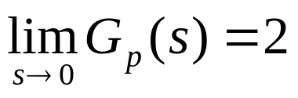
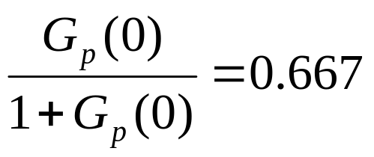
Example 6.3
dc Gain
G_{p}(s)
Fig. 6-1 (a)
取樣太慢! 至少需T=0.03~0.04.
τ: Time constant = 0.167 (ps. 0.667*63%=0.42)
A rule of thumb: at least five samples per time constant.
Final Value Thm.
dc gain
(4.14)
OL dc gain
CL dc gain

Slide 13
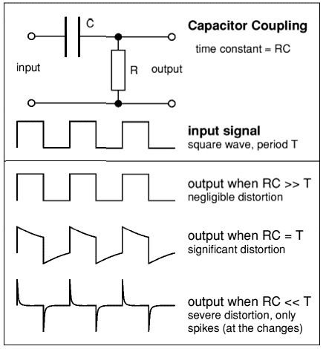
電容耦合 Capacitor coupling
Source: Link
電路的各個部份（sections）可能會用電容器彼此相連，因為電容器讓 AC（變化的）信號通過，而擋下DC（穩定的）信號。這稱作電容耦合（capacitor coupling 或 CR - coupling）。
它用在音響系統的級間，讓音響信號（AC）通過時，避免任何直流（DC）電壓出現其中，例如連接喇叭。它也用作示波器（oscillcope）的「AC」開關。
為了在音響系統中成功電容耦合，信號必須以極小或無失真地通過。這可以藉由RC 常數大於「最低頻信號所需的時間週期T（典型的 20Hz，T = 50 ms）」而達成。
A rule of thumb: at least five samples per time constant.

Slide 14
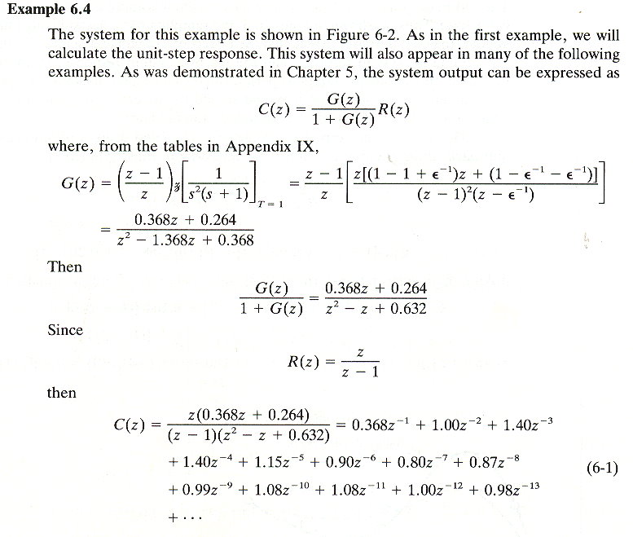
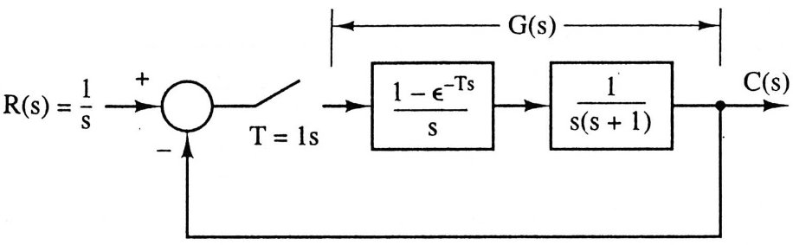
2nd-Order System
Appendix VIII
Approach-1: Z-Transform
Z⁻¹: Use Power Series

Slide 15
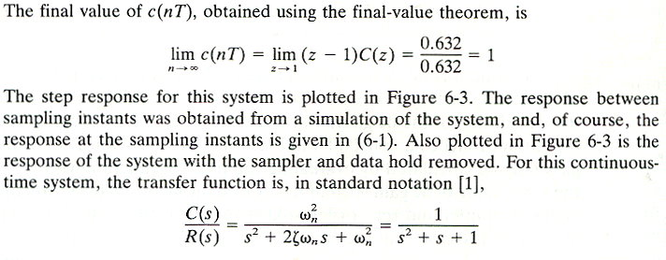
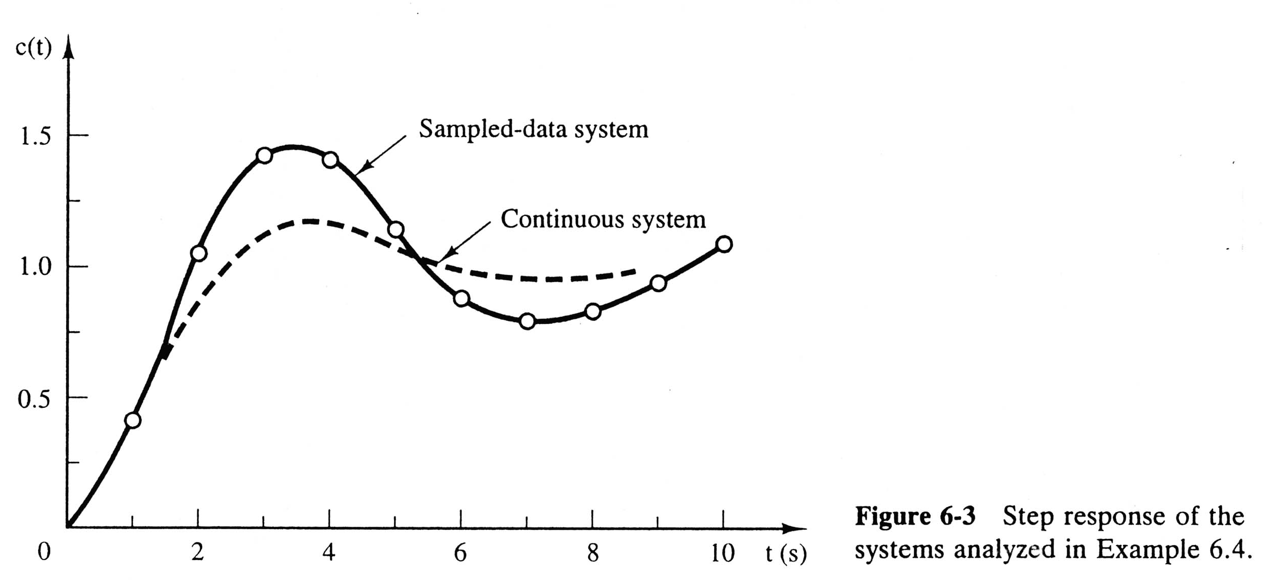
ω_{n}=1
ζ=0.5
%OS=18%
The sampling has a destabilizing effect.

Slide 16
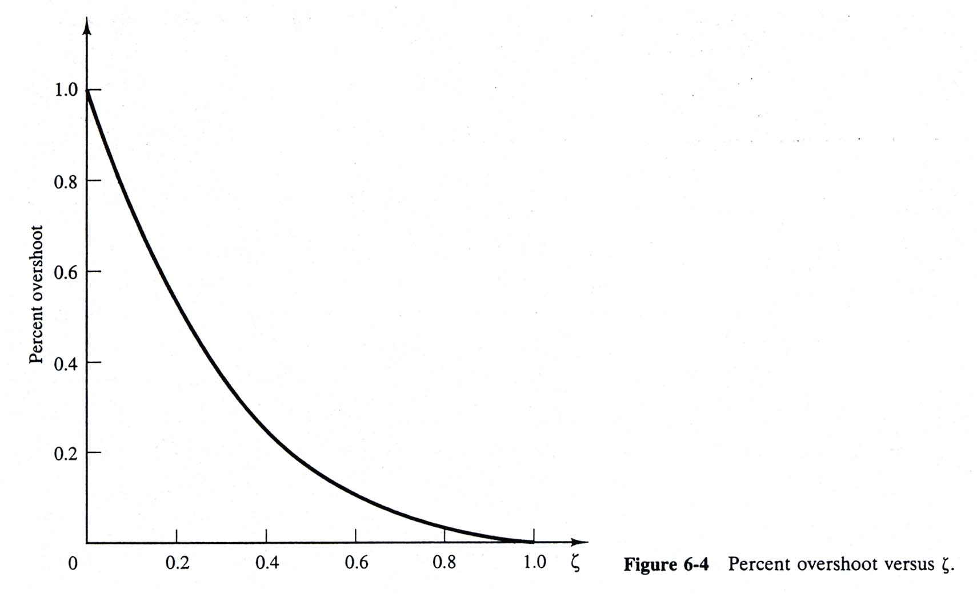
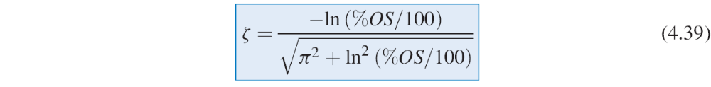
OS=0.18
ζ=0.5

Slide 17
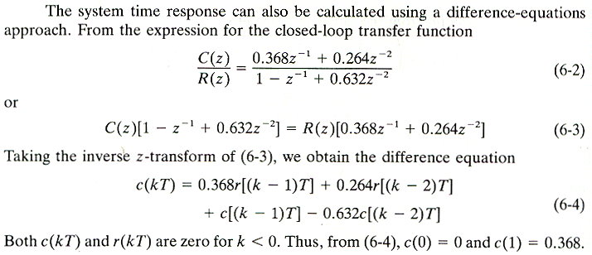
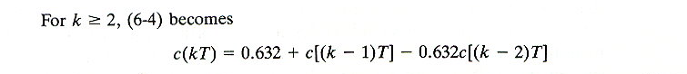
Approach-2: Diff. Eq.
Z⁻¹: Use Others

Slide 18
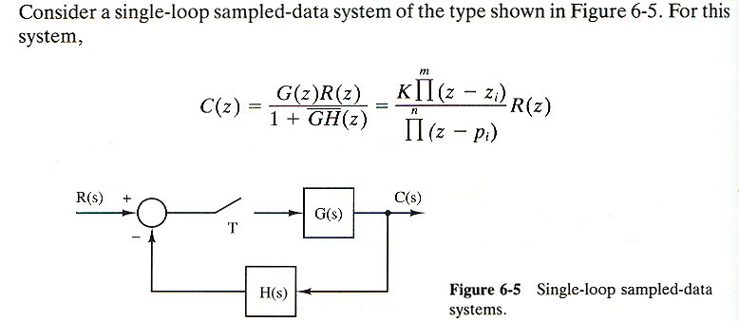
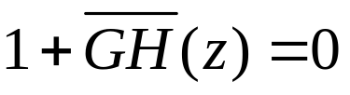
6.3 System Characteristic Equation
This equation is the system characteristic equation

Slide 19
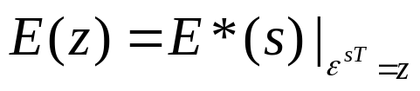
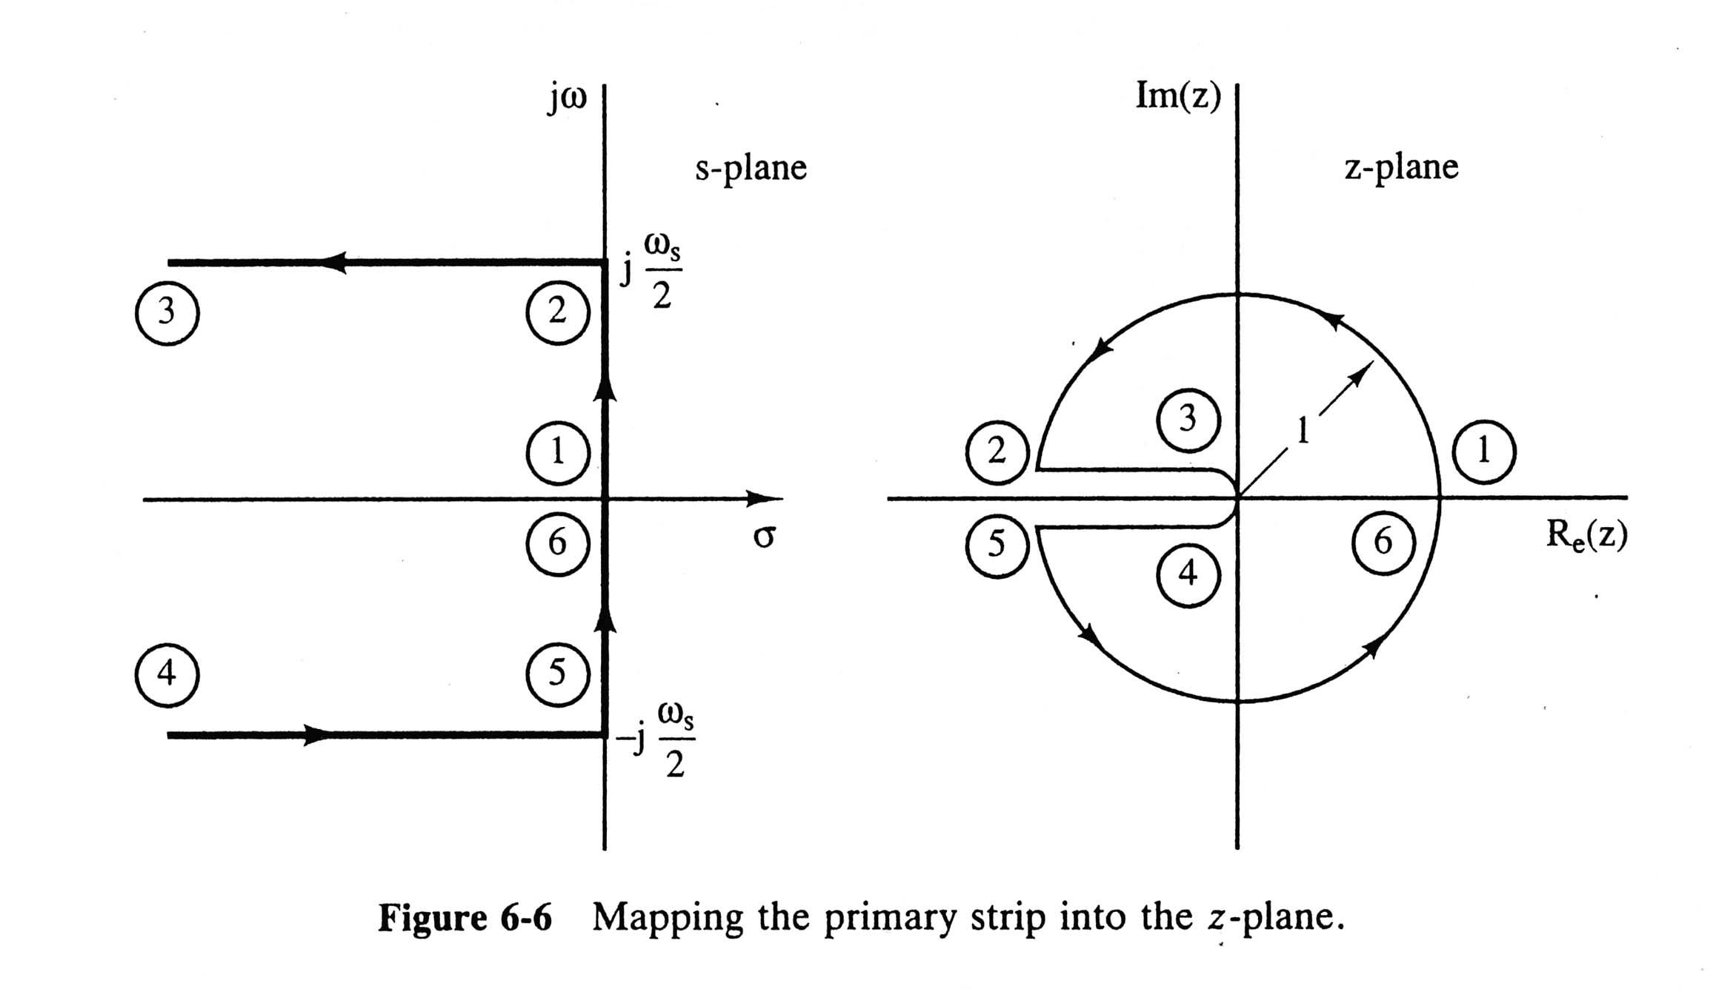
6.4 Mapping The s-Plane Into The z-Plane
E(s), E*(s), E(z)
Along the jω axis: σ=0
On the unit circle: |z|=1

Slide 20
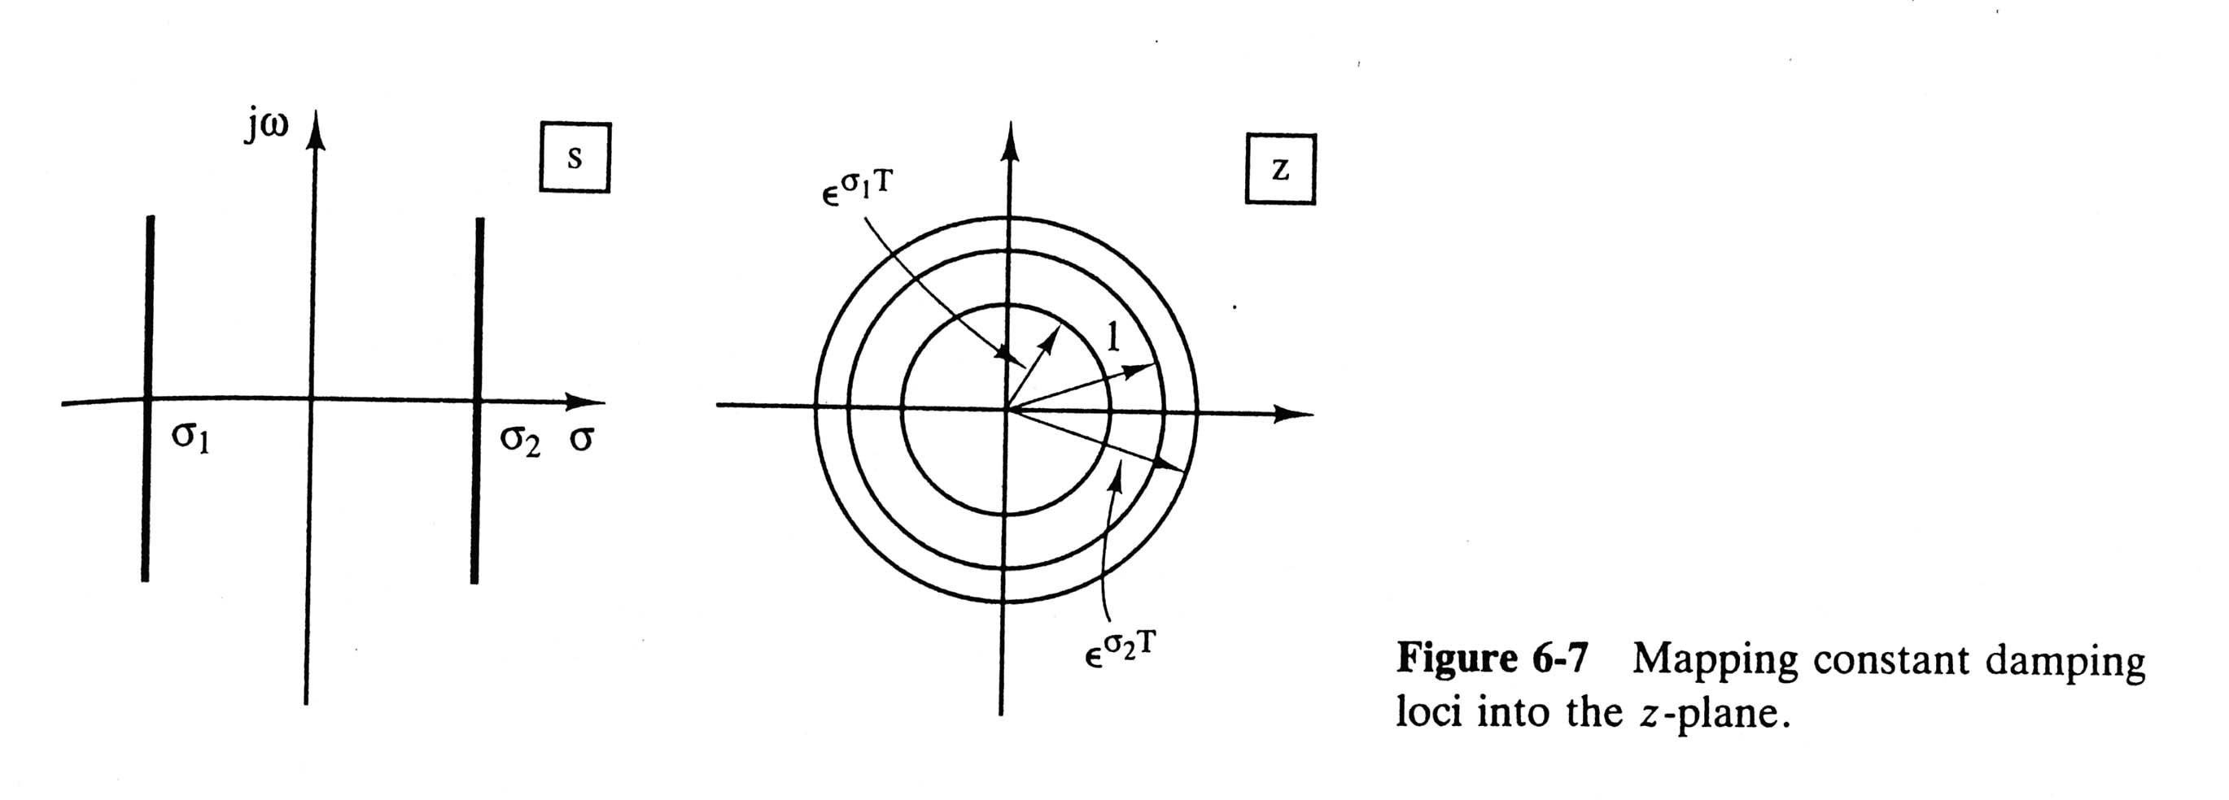

1) Constant Damping Loci σ_{d}: Exponential Damping Frequency
Circles
(jω axis: |z|=1)

Slide 21
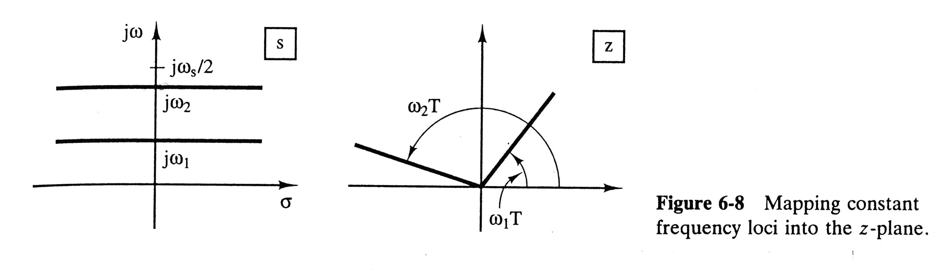
2) Constant Frequency Loci ω_{d}: Damped Frequency of Oscillation
ω = ω_{s}/2= π/Τ
ωΤ = π/2
ω = 0
ωΤ = 0
ωΤ = π
Lines
(with angle=ωT)

Slide 22
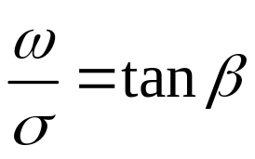
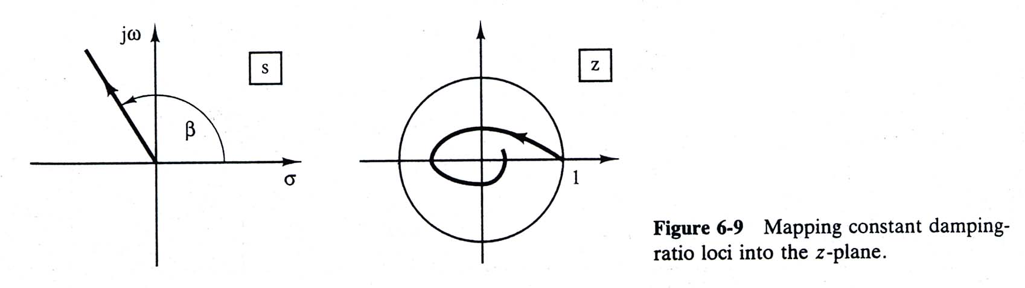
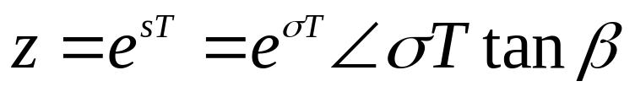
3) Constant Damping Ratio Loci: ζ
斜率
σ在 II-III quadrants為負值,
所以e^{σT}漸小.
ω=σ tanβ
Constant damping ratio
(6.6)

Slide 23
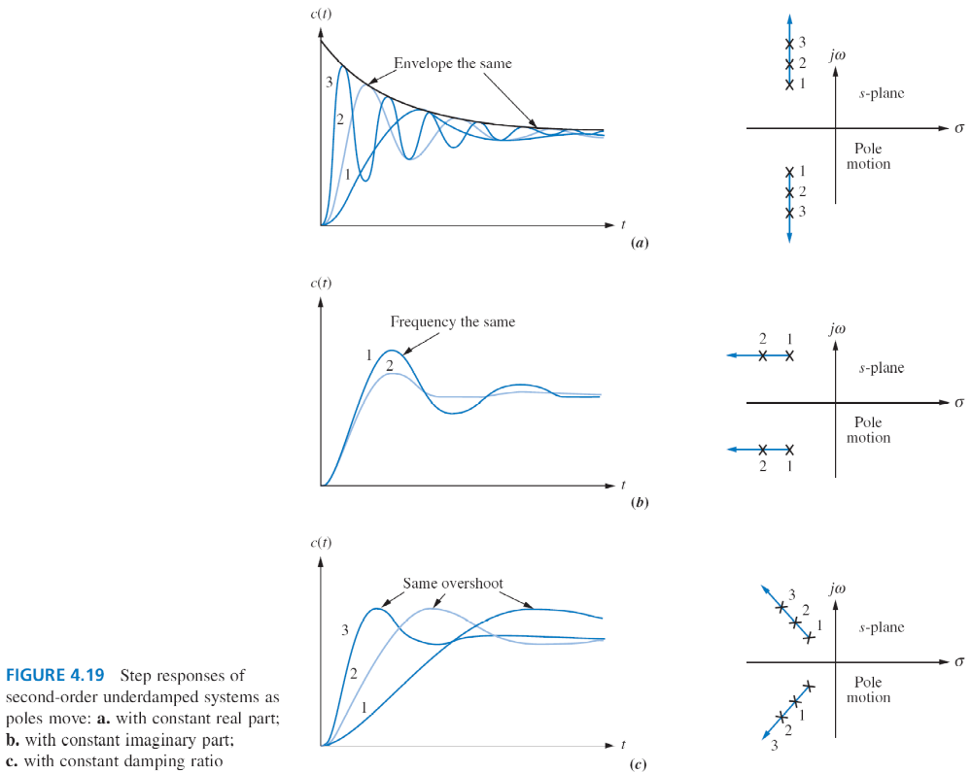
Supplementary Materials
Settling time
Peak time
%OS

Slide 24
Supplementary Materials
Real & distinct roots (P35)
Complex or Imaginary roots (P39)
Real & repeated roots (P38)
Fastest resp. w/o OS.

Slide 25
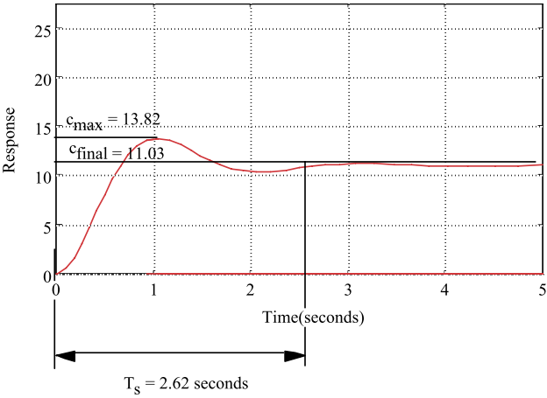
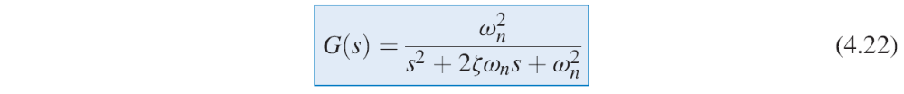
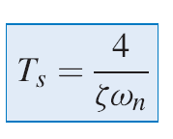
2nd-ORDER TRANSFER FUNCTIONS VIA TESTING
Supplementary Materials
  %OS → ζ
  T_{p} or T_{s} (both with ζ) → ω_{n}
  c_{final} = K / ω_{n}²

Slide 26
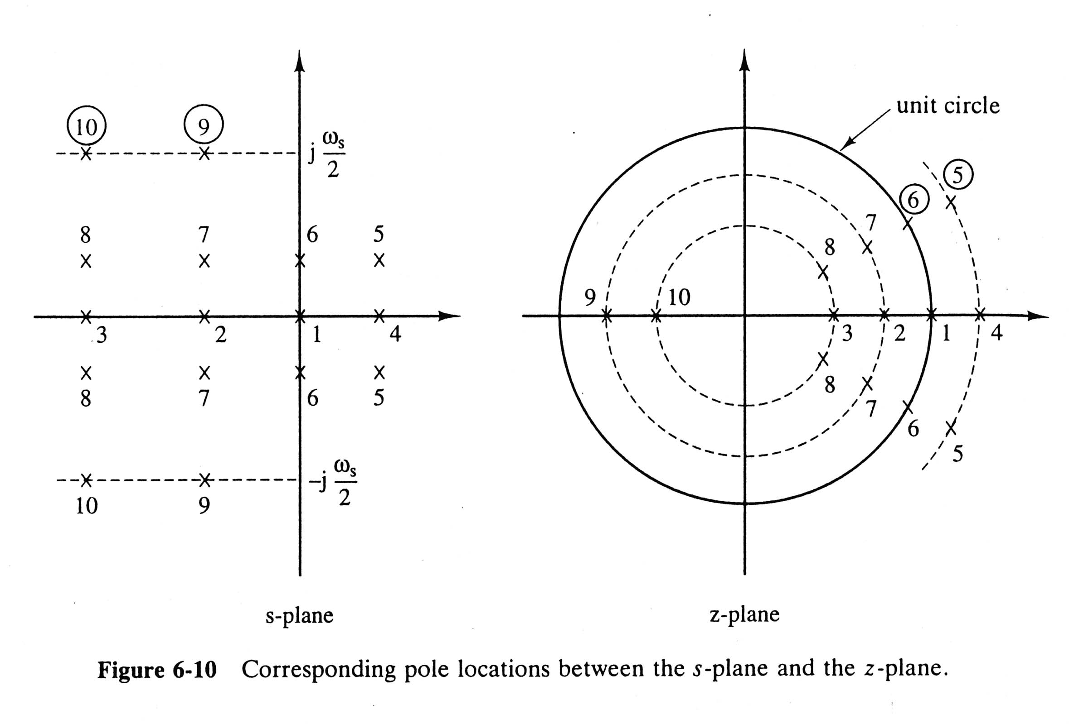
ω = ω_{s}/2= π/Τ
ωΤ = π
ωΤ = 0
ω=0

Slide 27
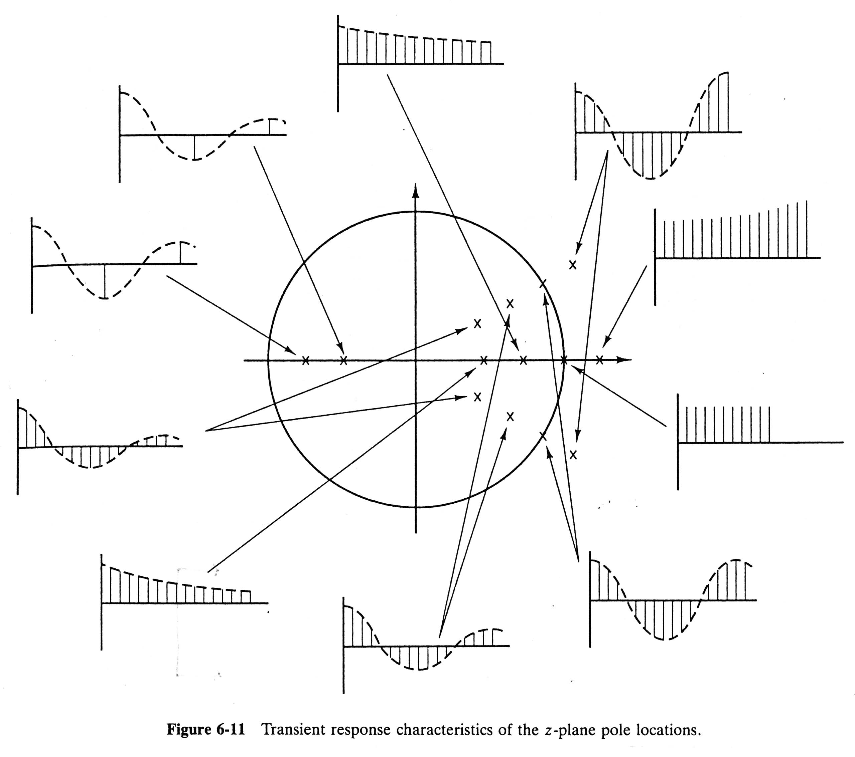
If (2nd-Order Syst.)-damped
1st-Order Syst.
unstable
ω_{d}=ω_{s}/2
(Nyquist freq.)
取樣慢(樣點少)
marginally stable
ωΤ = π
stable
Undamped
(Over/Critically)-damped
(Under)-damped

Slide 28
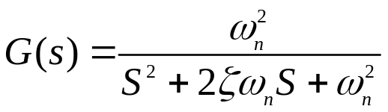
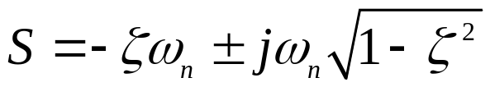
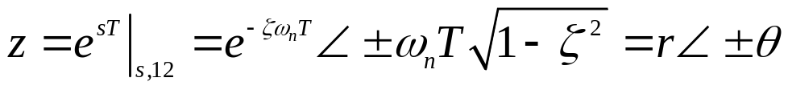








Given z-plane pole location,
find ζ, ω_{n}, and τ (T_{c})
Standard form the S-plane 2nd-order transfer function
Which has the poles
1, 2
The equivalent Z-plane poles occur at
S1, 2
Hence
or
Also
Taking the ratio of the last two equations
(6.8)
(6.9)
Time constant
(6.10)
Expressed as

Slide 29


Fig. 6-2

Slide 30

rad
CT viewpoint
To show the effect of sampling: destablizing effects!

Slide 31



(6.10)
Summary:
For real poles
T << τ
For complex poles, more
+ ωT < 1 rad. (~57 deg.)
Put poles to the vicinity of z = 1
(6.11)
The number of samples per time constant
Ex. If τ=1, T=0.25, then 1/0.25 = 4
T_{d}: the period of
the sinusoid
(6.12)
ω_{d}=ω_{s}/2
See slide: P27.

Slide 32

Shannon’s Sampling Theorem (1949)
Review Ch3.6 (P101)
If a function e(t) contains no frequencies higher than f₀ hertz, it is completely determined by giving its ordinates at a series of points spaced 1/(2f₀) seconds apart.
  e(t) is band-limited to one-sided baseband bandwidth f₀
  f_{s}: sampling rate
The theorem is commonly called the Nyquist sampling theorem.
But, why Nyquist?
Nyquist rate: 2f₀
Nyquist freq: f_{s}/2

Slide 33


7.1 INTRODUCTION
6.5 Steady-State Accuracy
START: Supplementary Materials from Nise Book!
DEFINITION AND TEST INPUTS
  Steady-state error: the difference between the input and the output for a prescribed test input as t → ∞.
APPLICATION TO STABLE SYSTEMS

Slide 34


Slide 35


Slide 36

EVALUATING STEADY-STATE ERRORS

Slide 37

Measured vertically

Slide 38

SOURCES OF STEADY-STATE ERROR
Error Sources
  Nonlinearity
  System Configurations
  Disturbance…

Slide 39


System Configurations
If c(t) is to be finite and nonzero,
a)
b)

Slide 40
Unity feedback
STEADY-STATE ERROR IN TERMS OF G(s)
For stable systems:

Slide 41

Step input
dc gain
Zero error
(see Tab 2.2, Item 10)
n≧1, i.e. at least one pure integration in the forward path.
Finite error
(no integration)
n=0

Slide 42

Ramp Input
Zero error
n≧2, i.e. at least two pure integrations in form of (7.14)
Finite error
(1 integration)
n=1
Infinite error
(no integration)
n=0

Slide 43

Parabolic Input
Zero error
n≧3, i.e. at least three pure integrations in form of (7.14)
Finite error
(2 integrations)
n=2
Infinite error
(1 or less)
n≦1

Slide 44



7.3 STATIC ERROR CONSTANTS AND SYSTEM TYPE
STATIC ERROR CONSTANTS
Test Inputs
u(t)
tu(t)
1/2 t²u(t)

Slide 45

STATIC ERROR CONSTANTS
As K_{p,v,a}↑
→ e(∞) ↓.

Slide 46

SYSTEM TYPE
Type n

Slide 47


Slide 48
7.4 STEADY-STATE ERROR SPECIFICATIONS
Example: Spec. K_{v}=1000 means
  Stable system
  Type 1
  Ramp input (test signal)
  Steady-state error is 1/K_{v}.
END: Supplementary Materials from Nise Book!

Slide 49




6.5 Steady-State Accuracy
Unity feedback system
(6.13)
The plant transfer function can always be expressed as
i
(6.14)
Define
i
Open-loop plant dc gain with all poles at z=1 removed.
(6.15)

Slide 50





(6.16)
Steady-state error
(6.17)
For the step-input

Slide 51






Define the position error constant, K_{p}
N=0
(6.18)
(6.19)
For N≧1, K_{p}=∞, e_{ss}=0.
For the unit-ramp input
T
Steady-state error
Define the velocity error constant, K_{v}
If N=0, K_{v}=0, e_{ss}=∞.
T
N=1
(6.21)
(6.20)
For N≧2, K_{v}=∞, e_{ss}=0.

Slide 52



Analysis

Slide 53



Design
K_{v}=100
Fig. 6.13

Slide 54

6.6 Simulation
Euler method

Slide 55

(P226) 4th-order Runge-Kutta rule
Two additional points
  Digital simulation: difference eq.
  Nonlinear systems

Slide 56
See Summary (P227)
Problems: 1, 2, 10, 12,
14, 15, 17
Test Bank

